Slide 1
A-TEAM
Shane, Jerome, Kannan and Siraj

Slide 2
Our Variables
Time Line : 2000 -2010
temperature Fluctuations
Population density
Target Variable: Energy Usage

Slide 3
Our Questions
What correlations can we draw between the changes in temperatures and energy consumption?
Looking at our graphs, which one of the two variables have the most impact on Energy consumption?
Do Temperature and Population variables affect energy consumption more together or independently?

Slide 4
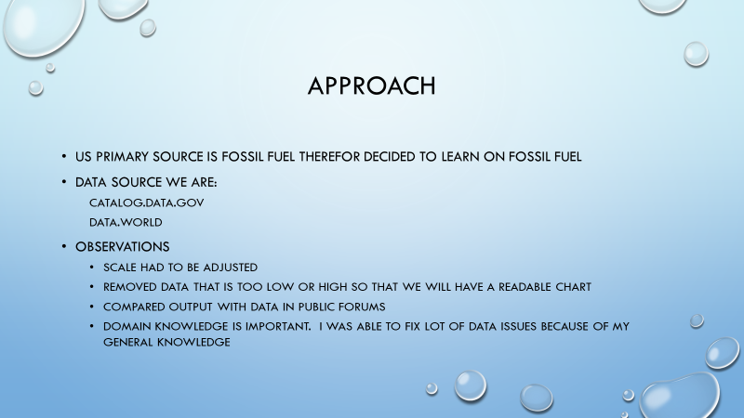
ENERGY USAGE (Kannan)

Slide 5
Datasources
https://www.census.gov/data/tables/time-series/demo/popest/intercensal-2000-2010-state.html

Slide 6
Population analysis
Us population by state has had a gradual increase across all 50 states including district of Columbia from 2001-2007 except Michigan
Less dense population areas consume more energy per person
The majority of population growth change stayed under 500,000 residents

Slide 7
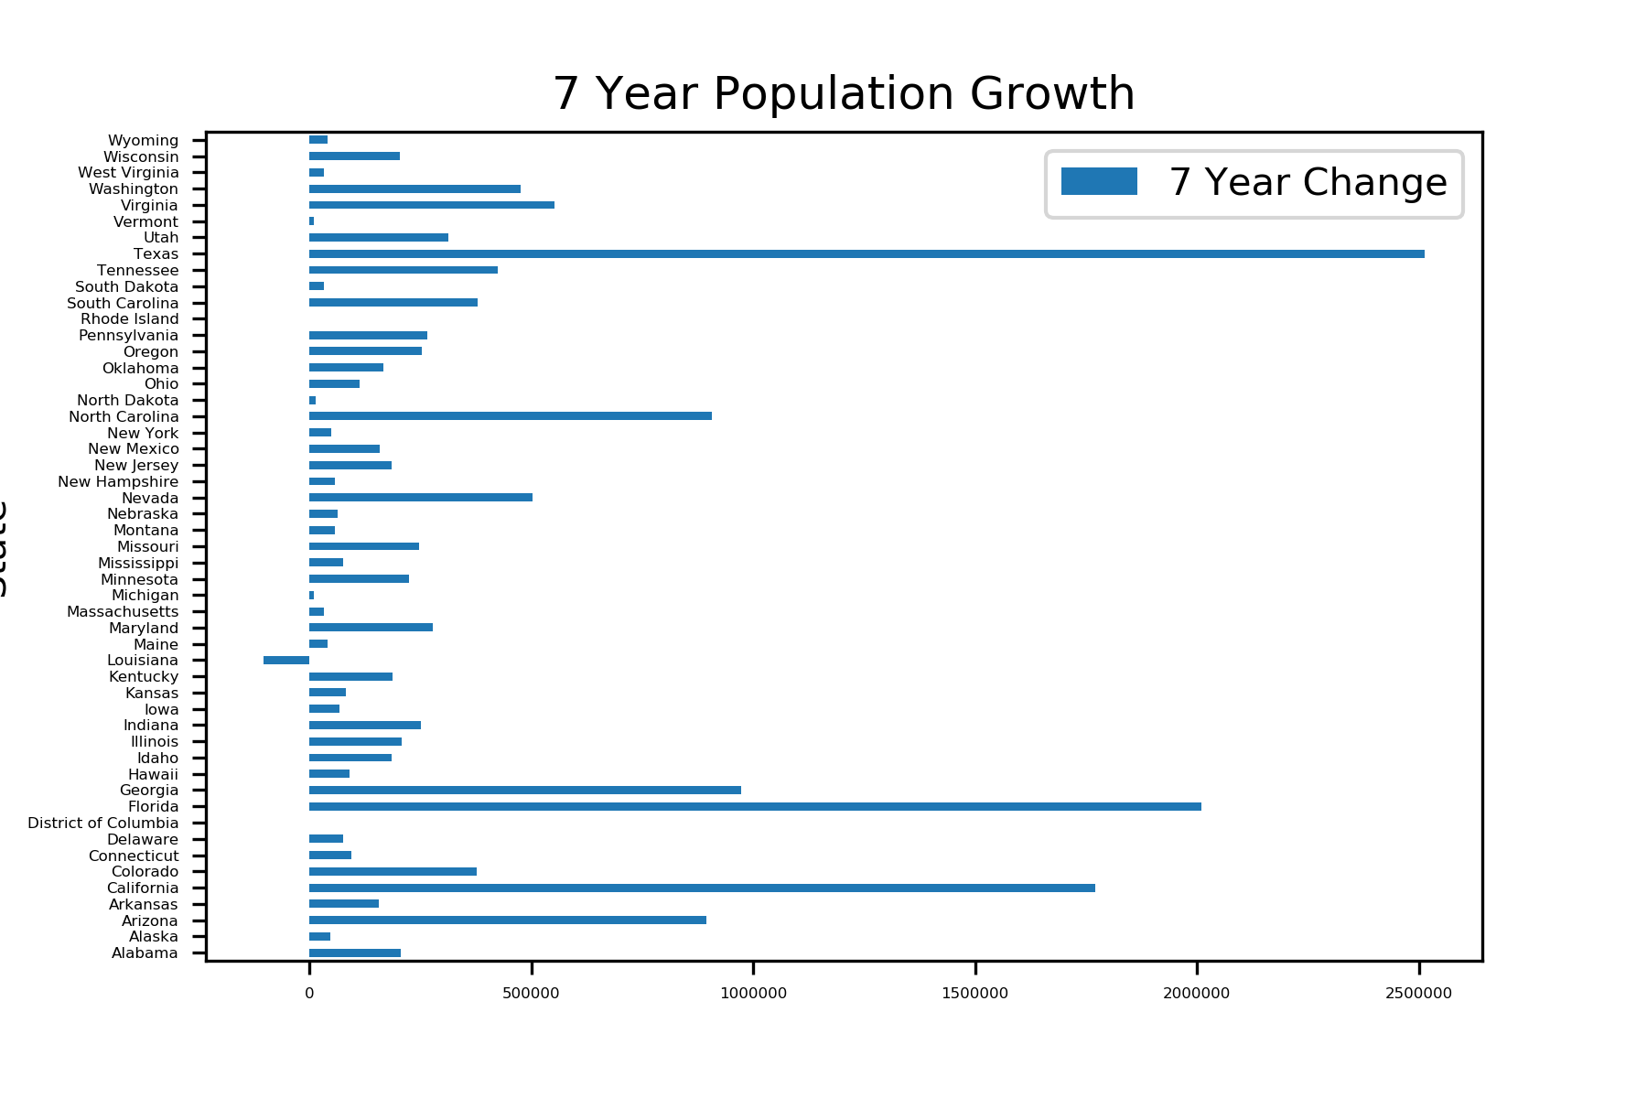
Statistical Analysis
Null: Energy consumption does not change over the 10 year period
P-value:
Result:

Slide 8
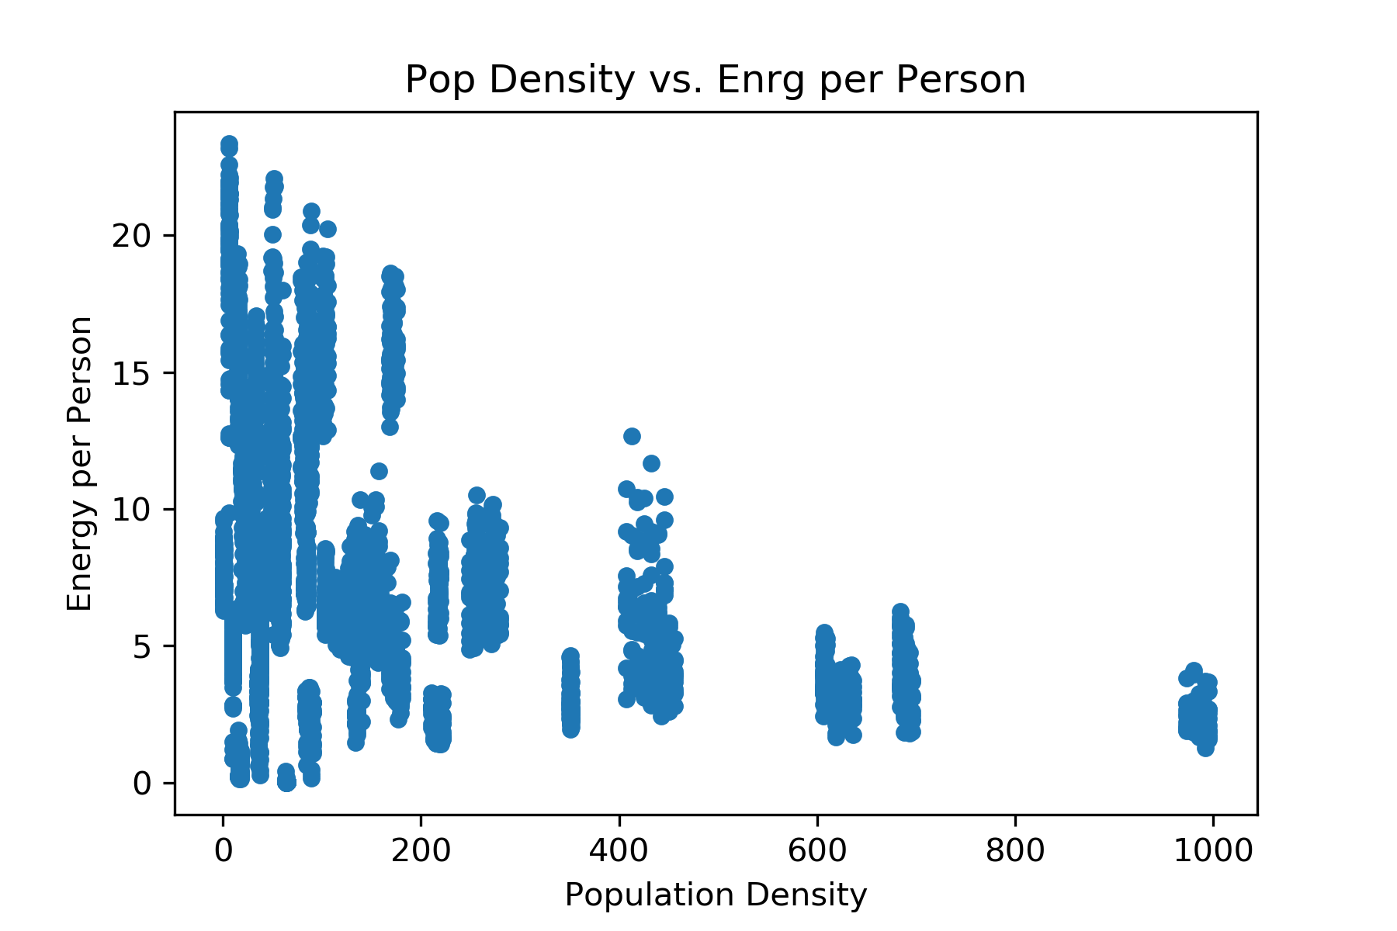
POPULATION density (Jerome)

Slide 9
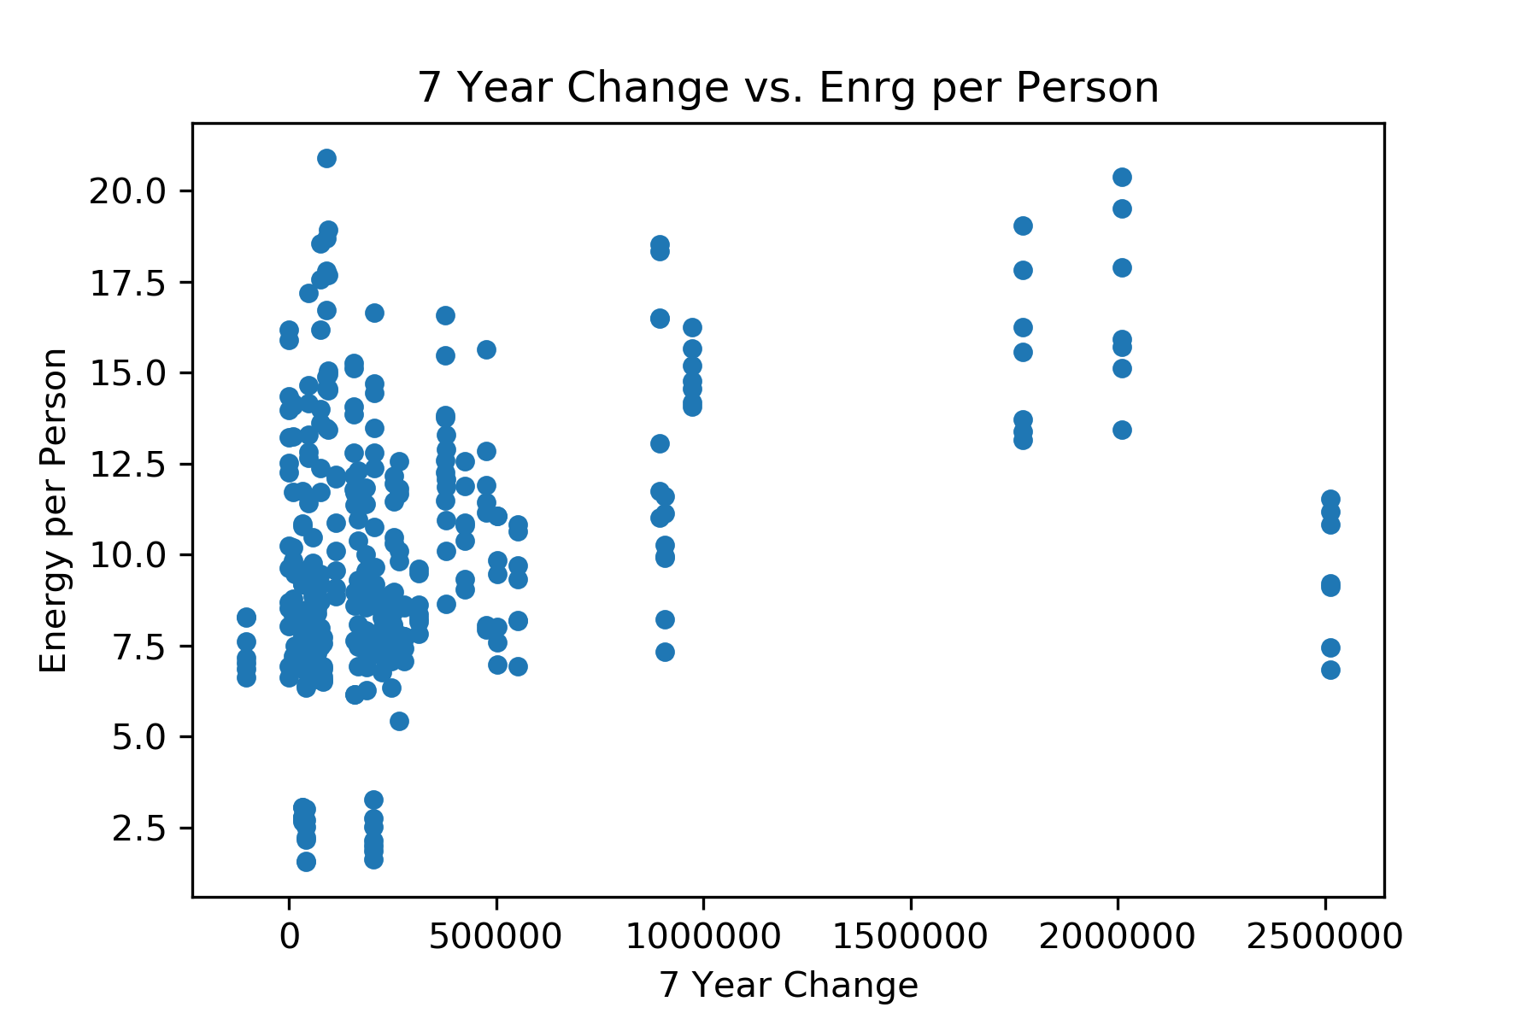
Statictical Analysis
Null:
P-Value:
Result

Slide 10
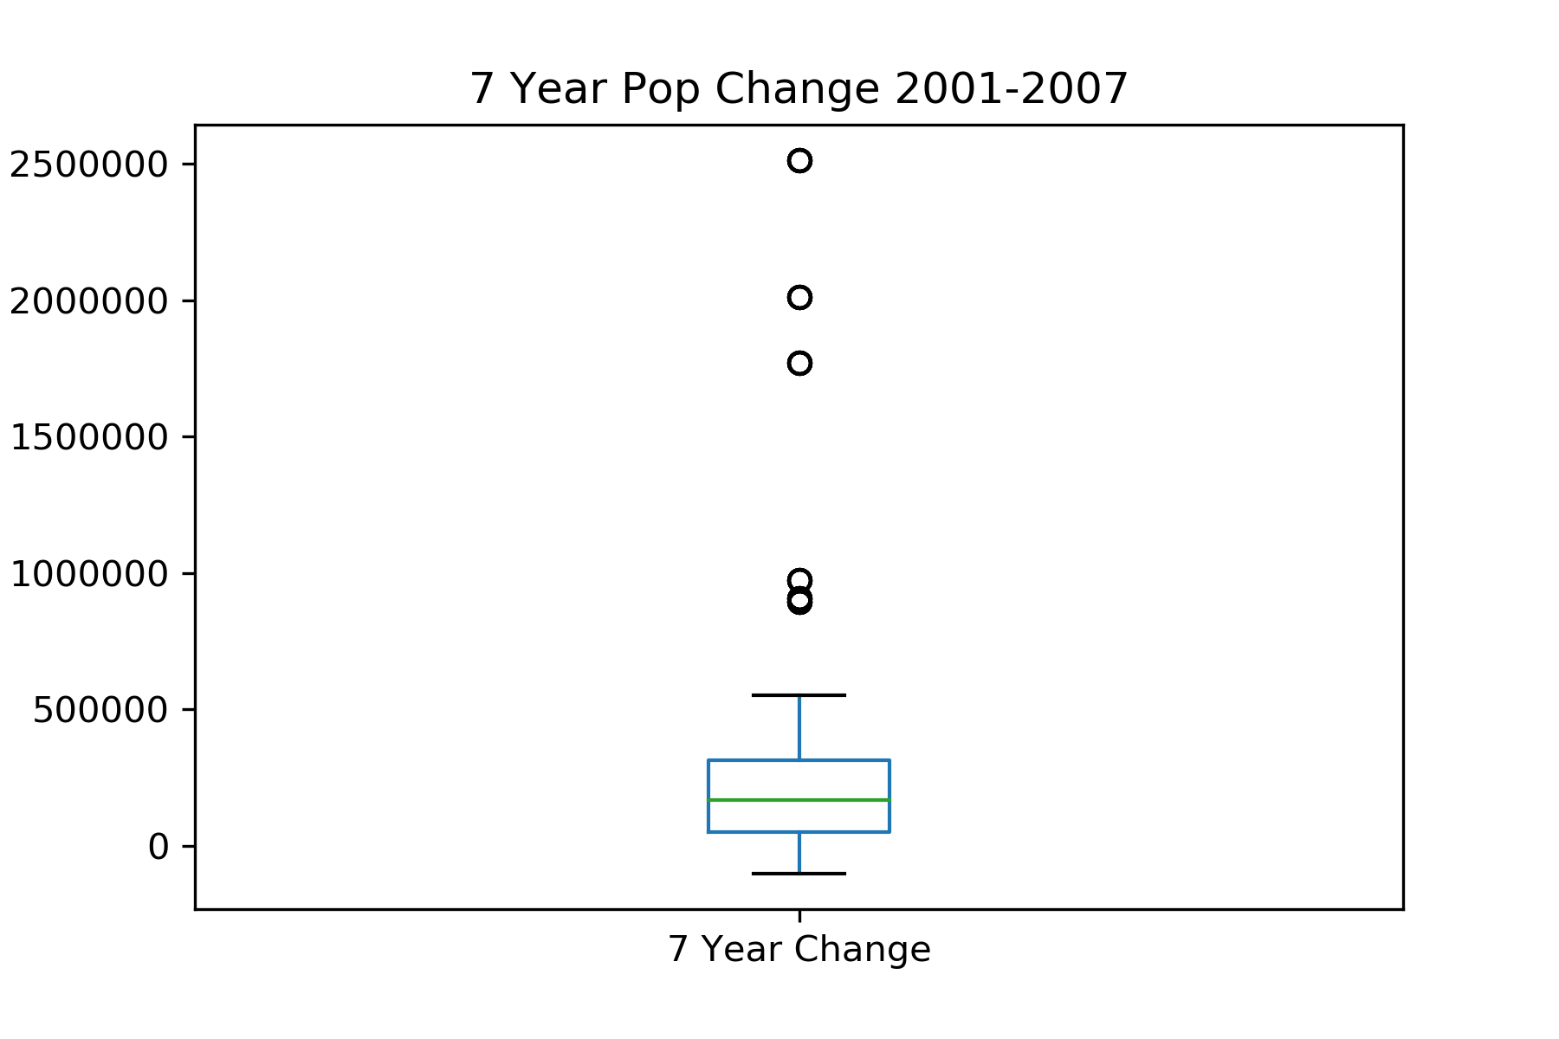
Temperature FLUCTUATIONS (Shane)

Slide 11
Statistical Analysis
Null Hypothesis:
P-Value:
Result:

